Slide 1


Comparatives & Superlatives

Slide 2
Adjectives are used to give extra information about people, places or nouns.
That old lady is very nice.
To compare two people, places or things, we use comparatives.
My grandmother is nicer than yours.
Our car is bigger than our neighbours’.

Slide 3
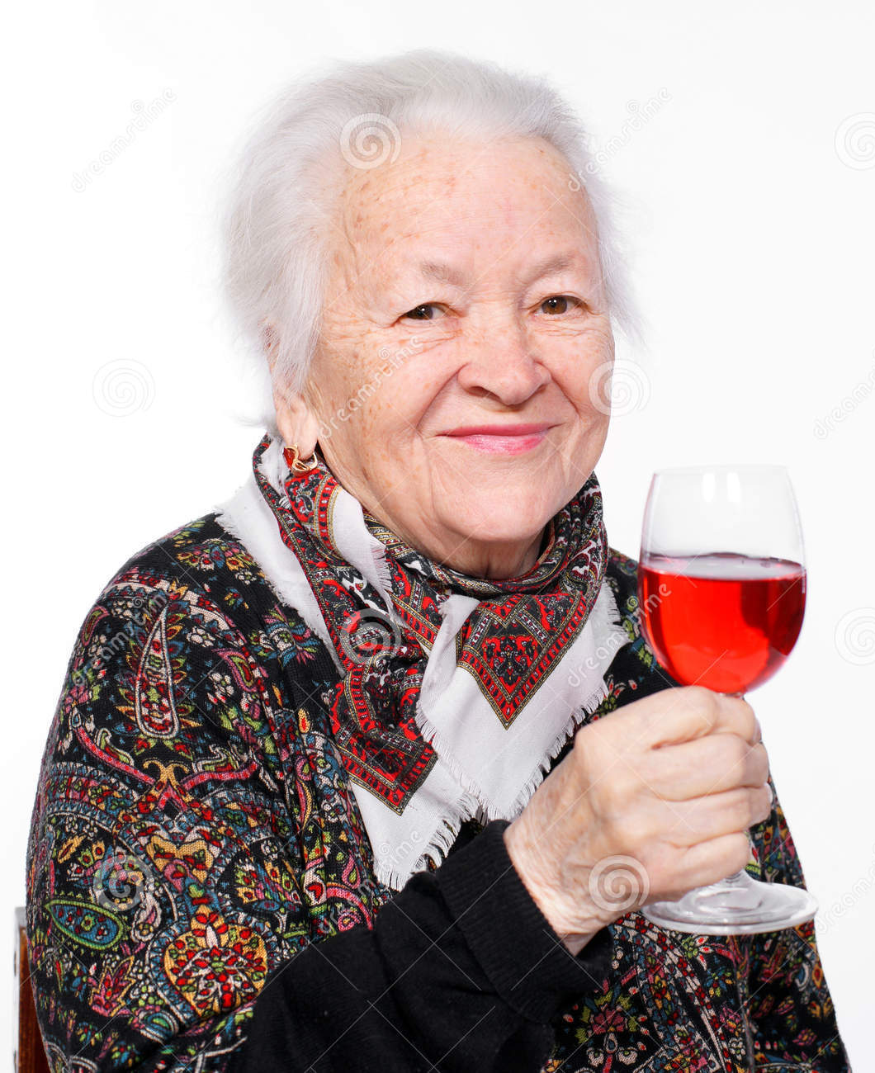
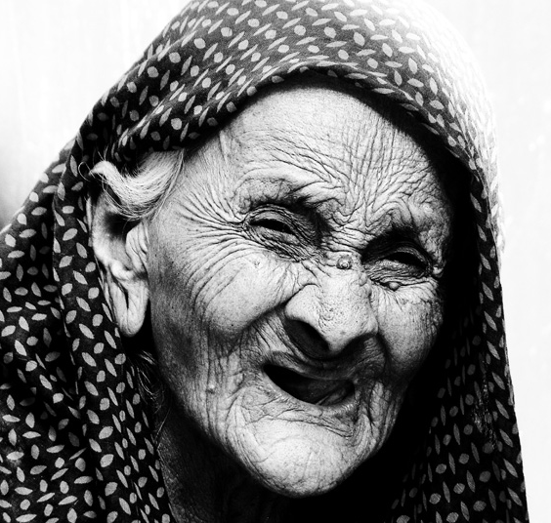
That woman looks old.
That woman looks …... than the other woman.

Slide 4
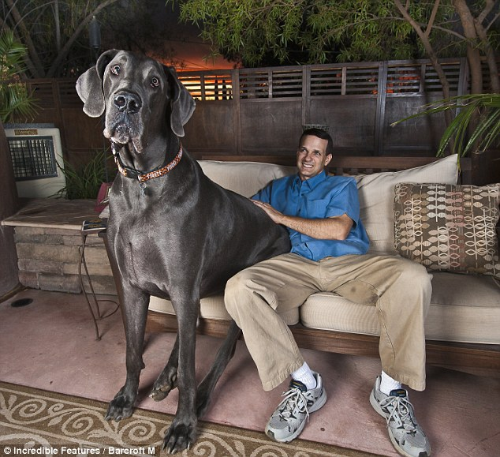
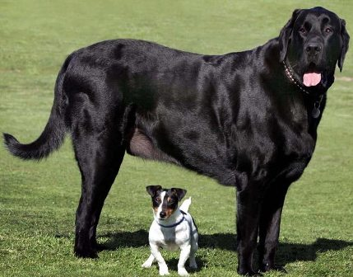
That dog is big.
That dog is ……. than the other one.

Slide 5
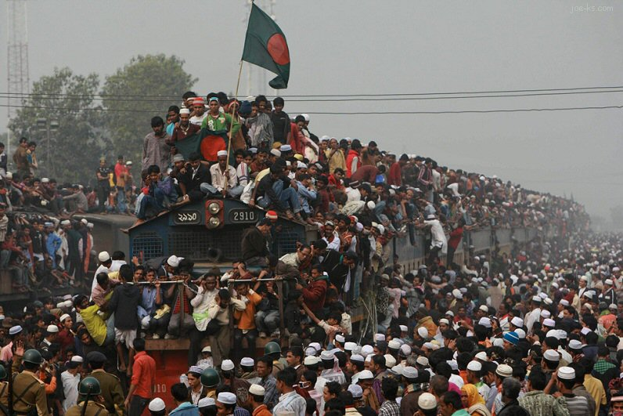
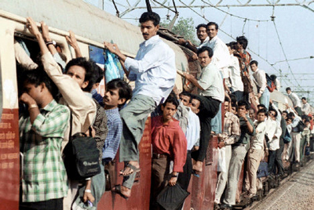
I don’t want to go on that train, it’s too busy!
Well, don’t take that one, it’s even………..!

Slide 6
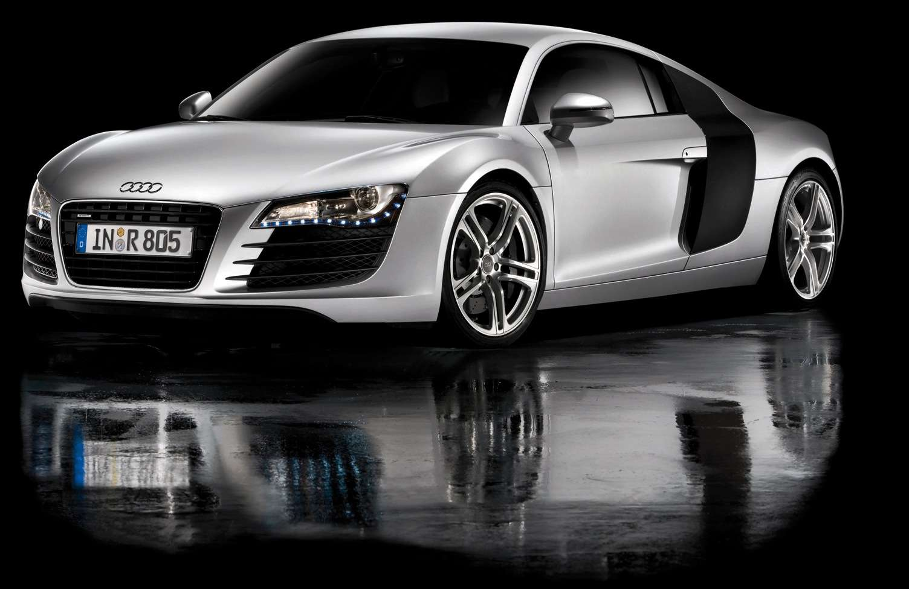
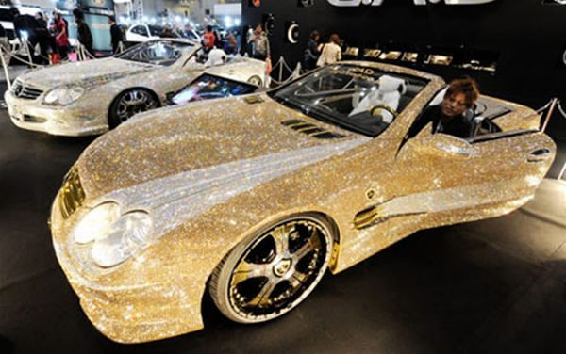
That’s a nice car, it must be expensive!
This one is covered in diamonds, that must be even ………………………..!

Slide 7
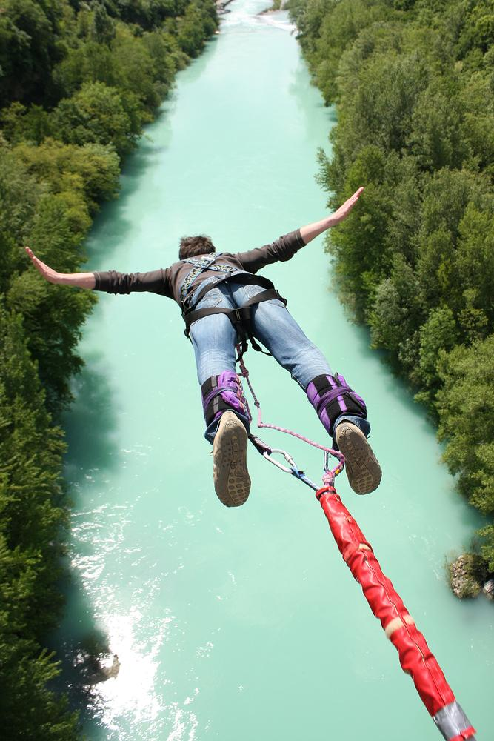
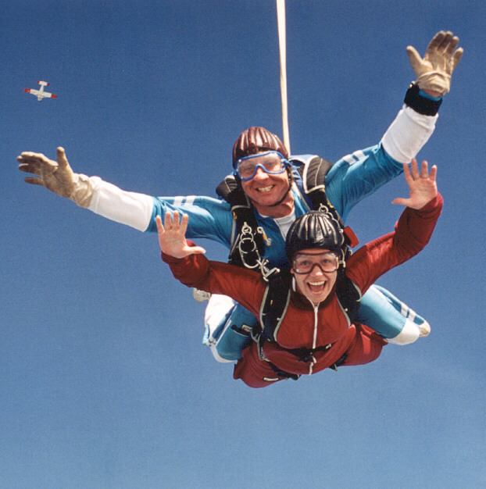
I’m not going bunjee jumping, that’s too exciting for me!
Than you shouldn’t take a parachute jump either, that’s even………………..!

Slide 8
Comparative
 | Adjective | Comparative
One syllable | Nice Old | Nicer Older
One syllable with short vowel + consonant | Big Hot | Bigger Hotter
-y at the end | Busy Friendly | Busier Friendlier
Two or more syllables | Expensive Interesting Exciting | More/less expensive More/less interesting More/less exciting
Irregular | Good Bad | Better Worse

Slide 9
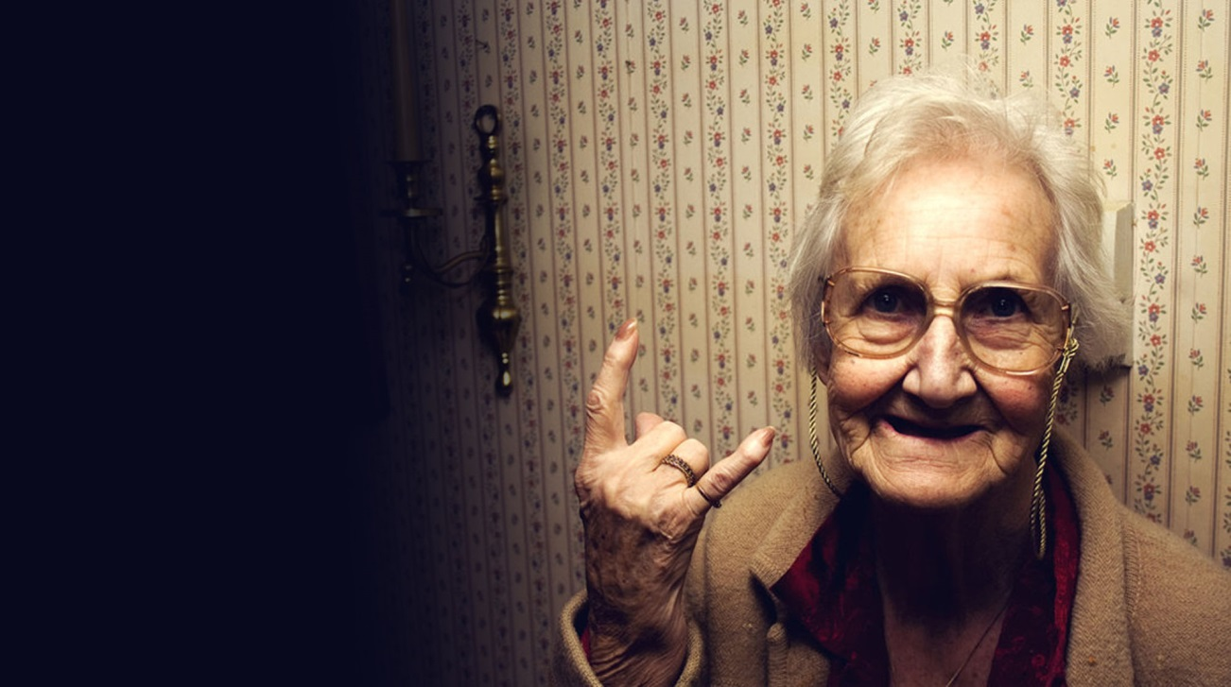
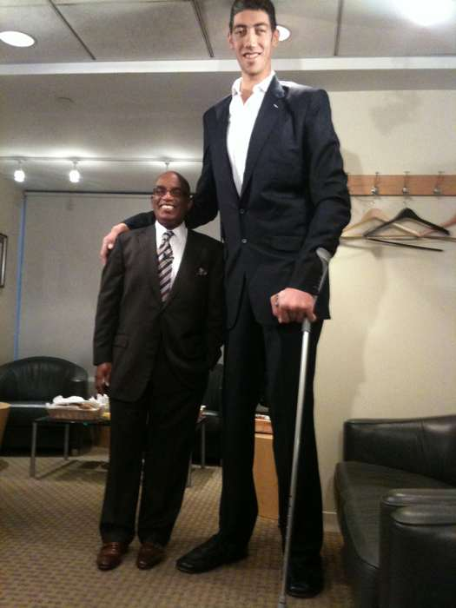
Your grandmother can be nice, and yours even nicer, but mine is the …………!
Do you think you are older than me? I am the ……….. in class!
My uncle is big but my father is …………… of the whole family!

Slide 10
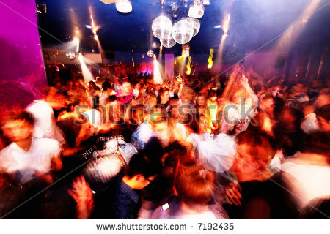
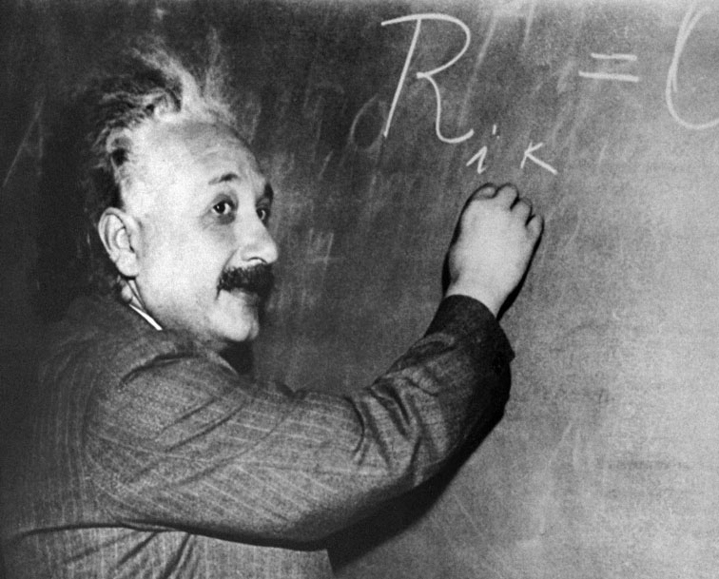
Jane is pretty but Marcy is the ………….. girl in class!
Last weekend I went to a disco, that was the …………… place I have ever been to!
Is your car made from diamonds? That must be the …………………………….. car in the world!
Our teacher tells very interesting stories but my friend says that her teacher tells the ………………………. stories ever!

Slide 11
Superlative
 | Adjective | Comparative | Superlative
One syllable | Nice Old | Nicer Older | The nicest The oldest
One syllable with short vowel + consonant | Big Hot | Bigger Hotter | The biggest The hottest
-y at the end | Busy Friendly | Busier Friendlier | The busiest The friendliest
Two or more syllables | Expensive Interesting Exciting | More/less expensive More/less interesting More/less exciting | The most/least expensive The most/least interesting The most/least exciting
Irregular | Good Bad | Better Worse | The best The worst

Slide 12
Extra practise
http://www.better-english.com/grammar/comp2.htm
http://www.englisch-hilfen.de/en/exercises/adjectives_adverbs/adjectives_comparison_sentences.htm
http://www.englisch-hilfen.de/en/exercises/adjectives_adverbs/adjectives_comparison_sentences2.htm
http://www.eslgamesplus.com/comparatives-superlatives-wild-zoo-animals-vocabulary-grammar-interactive-monkey-fun-activity/

